Slide 1





Bias and Fairness in AI for Medical Imaging
Fairness of AI in
Medical Imaging
Dr Andrew King
Biomedical Engineering Dept,
King’s College London
andrew.king@kcl.ac.uk
www.kclmmag.org

Slide 2

Talk overview
AI and the need for fairness
Definitions and terminology
Fair AI in medicine
A brief tour
What is (and isn’t) Fair AI
Summary and resources
`

Slide 3
Learning objectives
At the end of this session, you should be able to:
Explain the meaning of fairness/bias in AI, and describe why it has become an important issue recently
Explain some fairness definitions using common terminology for talking about bias in AI
Explain some approaches for addressing or mitigating bias in AI
Discuss some key papers on fairness in AI in medicine and beyond
Describe the differences between fair AI in medicine and other applications

Slide 4

AI and the need for fairness

Slide 5

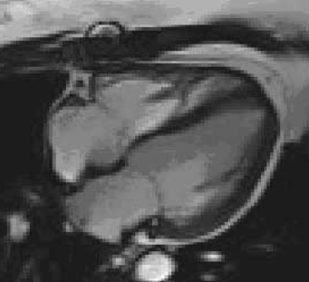
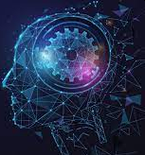


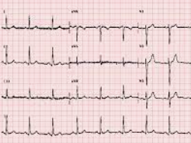
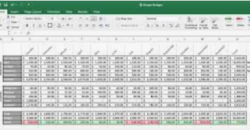
AI models are “black boxes” …?
What is a “black box” AI model?
→ A model that cannot be (easily) understood/inspected by a human
Data
Output

Slide 6
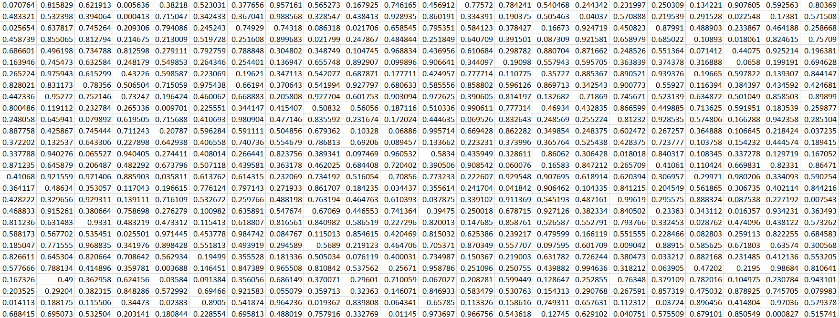
Are any AI models “black boxes”
In reality, in most cases we can inspect black box AI models …
Data
Output
But can we understand them?

Slide 7
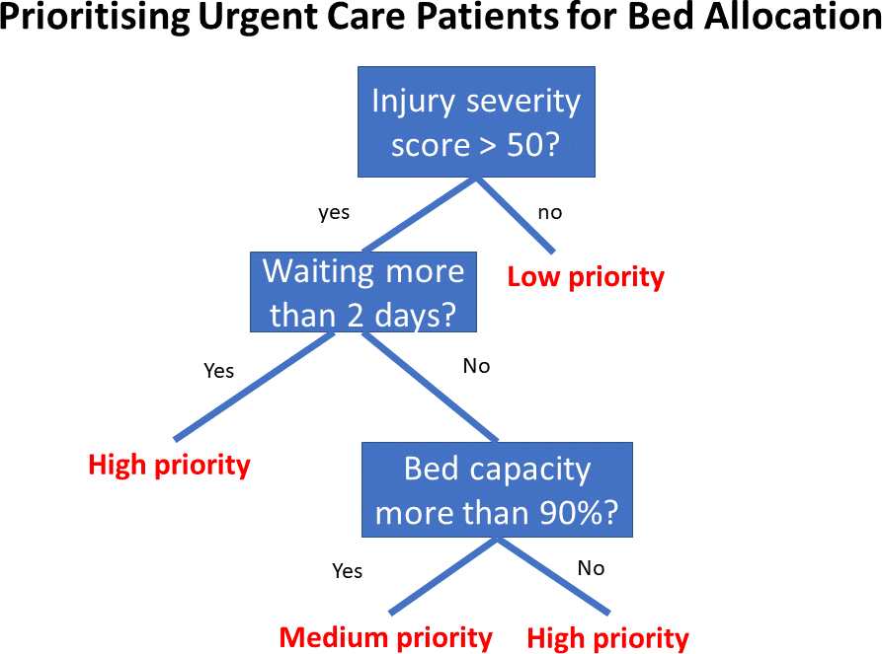
Are all AI models “black boxes”?
“White box” AI: refers to models that can be understood by humans
E.g. Decision trees:

Slide 8
White box AI
White box models aim to make AI models more “transparent”, i.e. to enable humans to understand better how outputs were produced
We can also call this interpretability or explainability
Why is white box AI useful?

Slide 9
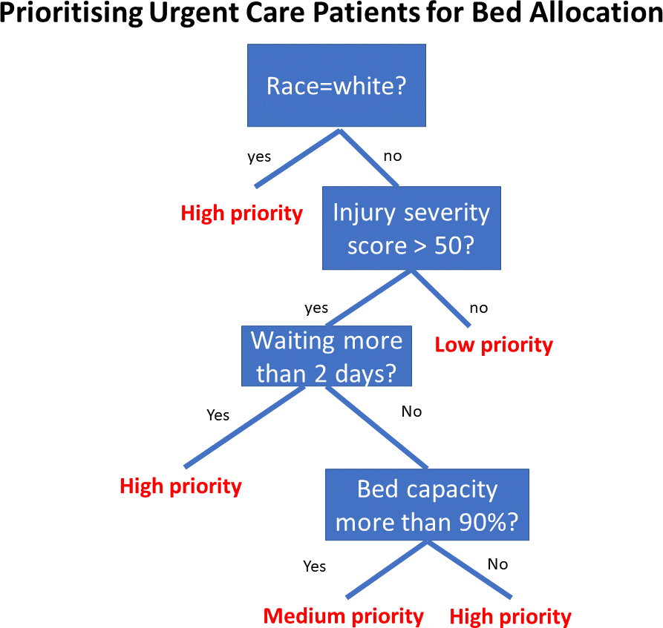
Why can white box AI be useful?
White box model
Black box model
!!
White box models enable us to more easily uncover potential bias or toxic behaviour, and also address/remove it.

Slide 10
So do we have to use simple white box models?
Problem: the best-performing techniques, especially on more complex tasks, are black box AI models
So how can we know if they are biased, and if they are what can we do about it?
Since the advent of black box models like deep learning we have seen two things:
A significant improvement in performance
A significant reduction in interpretability
Fair AI is mostly a response to the second point (but also partly the first …)
Fair AI …

Slide 11
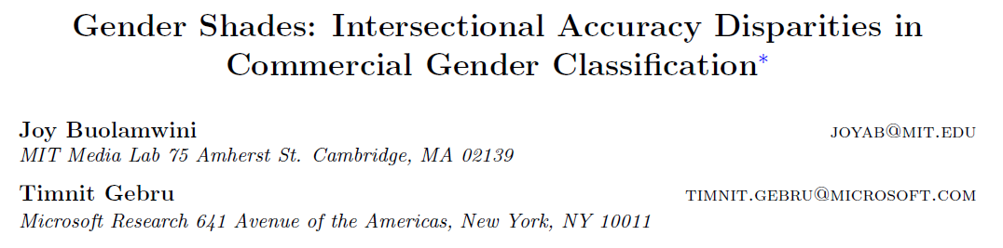
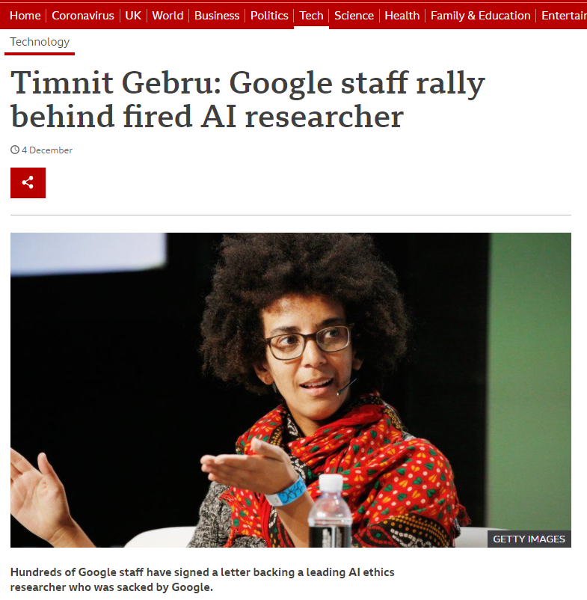
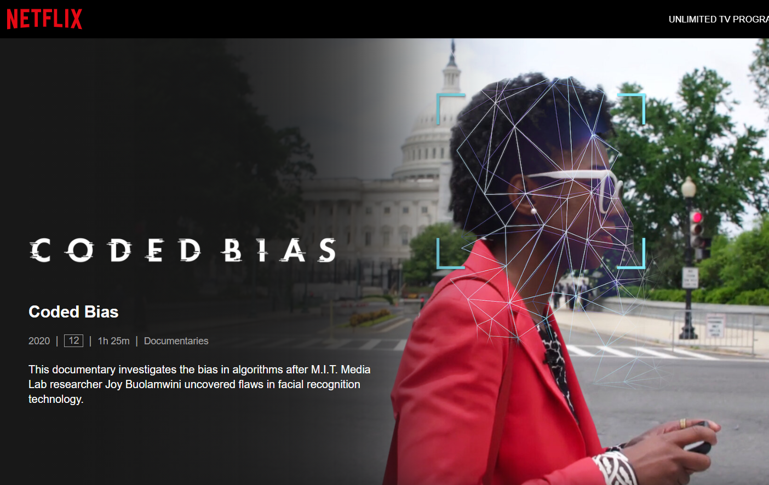


The birth of Fair AI? Gender Shades …
Landmark paper in 2018:
Algorithmic Justice League: www.ajl.org/
Distributed AI Research Institute: www.dair-institute.org/

Slide 12
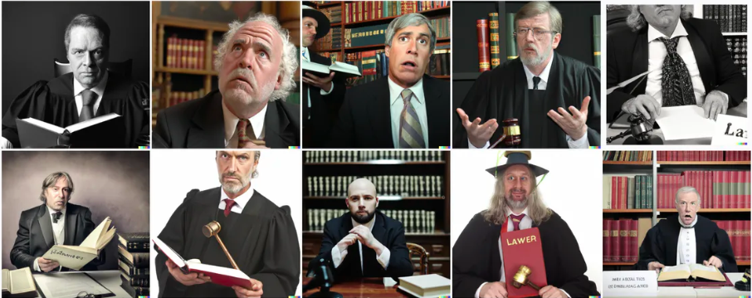

Bias in image generation
Open AI’s DALL-E 2 pictures of lawyers …
… and flight attendants
https://www.vox.com/future-perfect/23023538/ai-dalle-2-openai-bias-gpt-3-incentives

Slide 13
Definitions & terminology

Slide 14
Definitions and terminology
In the context of decision-making, fairness refers to:
The “absence of any prejudice or favouritism toward an individual or a group based on their inherent or acquired characteristics”
Fairness in AI refers to methods for assessing and/or addressing such prejudice/bias, i.e. bias = different levels of performance for different groups of subjects (e.g. races or sexes)
Terminology:
Protected attribute: the characteristic(s) for which fairness needs to be ensured, e.g. sex, race (a.k.a. sensitive attribute)
Protected group: a set of samples with the same value(s) for the protected attribute(s)

Slide 15
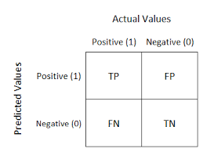
Definitions of fairness
Fairness can be defined in a number of different ways
We will consider an AI classifier for detecting a disease (e.g. breast cancer) from a medical image
Our protected groups are White subjects and Black subjects
In the definitions, we will refer to the numbers of true positives (TP), true negatives (TN), false positives (FP) and false negatives (FN)

Slide 16
Definitions of fairness – equalised odds
Equalised odds:
“… the probability of a person in the positive class being correctly assigned a positive outcome and the probability of a person in a negative class being incorrectly assigned a positive outcome should both be the same for the protected … groups”
I.e. equal true positive rate (TPR) & false positive rate (FPR) for each protected group
TPR = TP / (TP + FN) (this is also known as the sensitivity)
FPR = FP / (FP + TN) (this is one minus the specificity)
N. Mehrabi, et al. (2021) "A Survey on Bias and Fairness in Machine Learning", ACM Computing Surveys.

Slide 17
Definitions of fairness – demographic parity
Demographic parity:
“The likelihood of a positive outcome should be the same regardless of … the protected group”
I.e. an equal chance of being classified positive for each protected group
Predicted positive rate = TN + FP / (TN + FP + TN + FN) (Note this does not depend on the ground truth)
N. Mehrabi, et al. (2021) "A Survey on Bias and Fairness in Machine Learning", ACM Computing Surveys.

Slide 18
Definitions of fairness – equal opportunity
Equal opportunity:
“The probability of a person in a positive class being assigned to a positive outcome should be equal for both protected … group’s members”
I.e. the true positive rate (=sensitivity) should be the same for each protected group
TPR = TP / (TP + FN) (this is also known as the sensitivity)
N. Mehrabi, et al. (2021) "A Survey on Bias and Fairness in Machine Learning", ACM Computing Surveys.

Slide 19
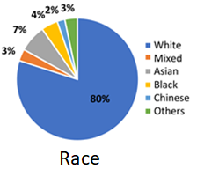
Source of bias
Bias is often (but not always) caused by an imbalance between protected groups in the training data
E.g. this is the race breakdown in the widely-used UK Biobank dataset:
When this level of imbalance is combined with differences in the data for different protected groups (e.g. races), it can cause the AI model to optimize its performance for the over-represented group(s)

Slide 20
Addressing bias
Prepare data
Train
model
Deploy
model

Slide 21
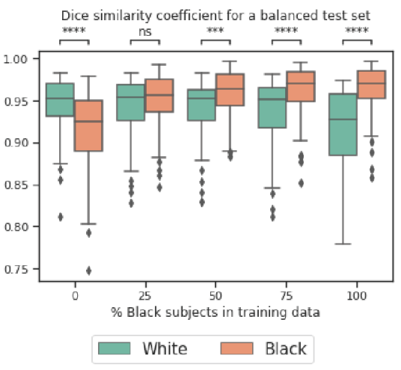
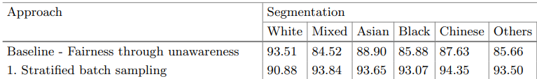
Bias mitigation - preprocessing
Address data imbalance:
If we can, add more training data for protected groups that are under-performing
If not, can use data augmentation
Reweighing:
When computing the loss of an AI model, add a weighting to increase the importance of under-represented protected groups
Over-sampling:
When sampling training data in minibatches, over-sample from the under-performing group
T. Lee, et al. (2022) "A Systematic Study of Race and Sex Bias in CNN-based Cardiac MR Segmentation", Proceedings MICCAI STACOM.
Puyol-Antón, et al, "Fairness in Cardiac MR Image Analysis: An Investigation of Bias Due to Data Imbalance in Deep Learning Based Segmentation", Proceedings MICCAI, 2021

Slide 22
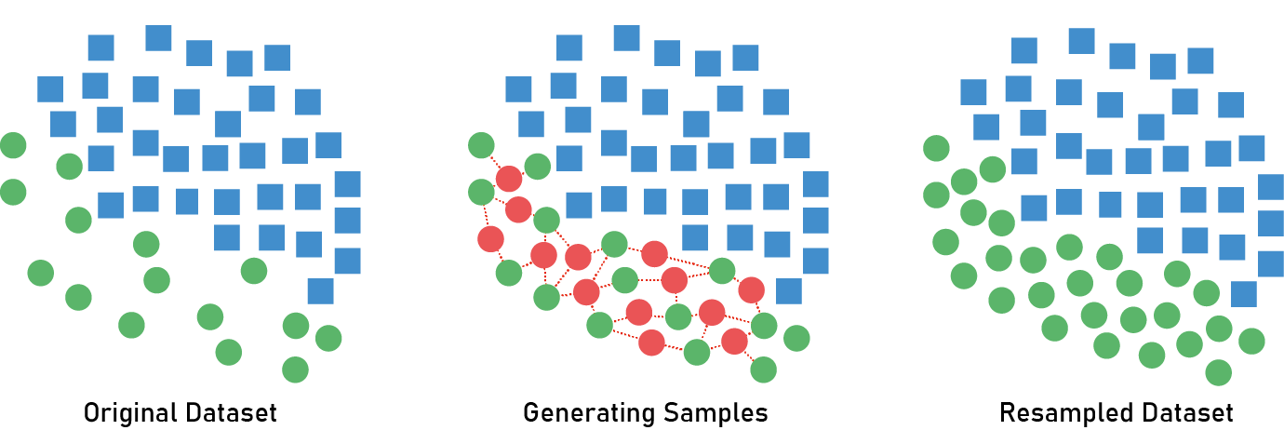
Bias mitigation – preprocessing: example
SMOTE: Synthetic Minority Oversampling Technique
SMOTE is a widely used data augmentation technique in machine learning for imbalanced datasets
It works by creating synthetic samples of the minority class by interpolating between existing minority class instances
Normally used to address class imbalance problem, but can also be applied to boost representation of minority protected groups -> Fair-SMOTE
Steps in SMOTE
Step 1: Select a random sample from the minority class
Step 2: Choose one of its k-nearest neighbours
Step 3: Create a synthetic instance by interpolating between the original sample and the neighbour
Step 4: Repeat until the desired level of oversampling is achieved
J. Chakraborty, et al. (2021) "Bias in Machine Learning Software: Why? How? What to Do?", Proceedings ESEC/FSE.

Slide 23
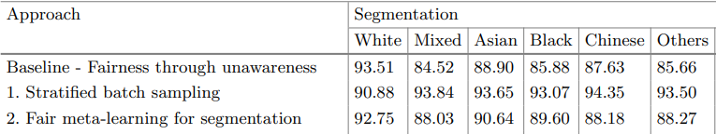
Bias mitigation - inprocessing
Meta-fair classifier:
Co-train model for intended task with a protected attribute classifier model
Representation neutralisation:
Modify loss to avoid encoding of protected attributes (e.g. adversarial training)
Training for fairness:
Modify loss encourage a particular fairness criterion (e.g. Group DRO)
Puyol-Antón, et al, "Fairness in Cardiac MR Image Analysis: An Investigation of Bias Due to Data Imbalance in Deep Learning Based Segmentation", Proceedings MICCAI, 2021
Du, et al, "Fairness via Representation Neutralization", Proceedings NeurIPS, 2021
Sagawa, et al, "Distributionally Robust Neural Networks for Group Shifts: On the Importance of Regularization for Worst-case Generalization", Proceedings ICLR, 2020

Slide 24
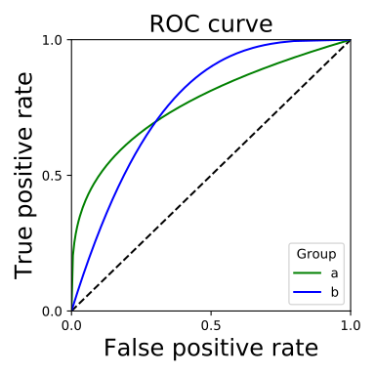
Bias mitigation - postprocessing
Adjust classification thresholds:
For classification models, adjust thresholds to equalise FPR/TPR between protected groups (equalized odds) or just TPR (equal opportunity)
Hardt, et al, "Equality of Opportunity in Supervised Learning", Proceedings NeurIPS, 2016

Slide 25
Fair AI in medicine

Slide 26
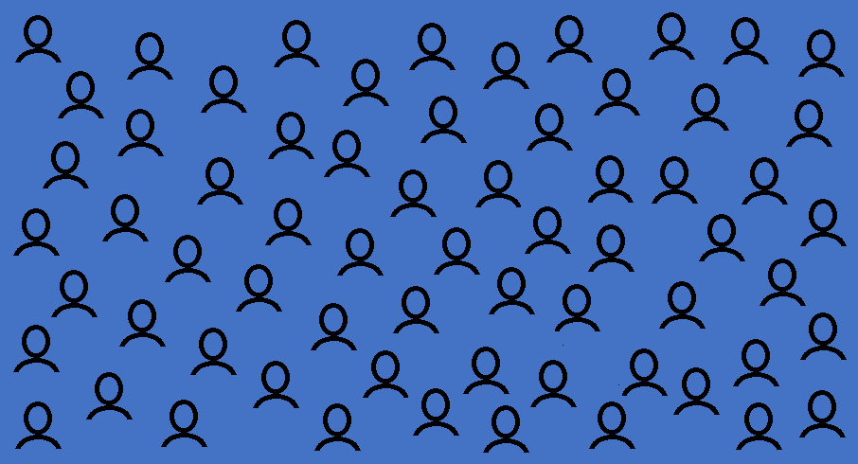
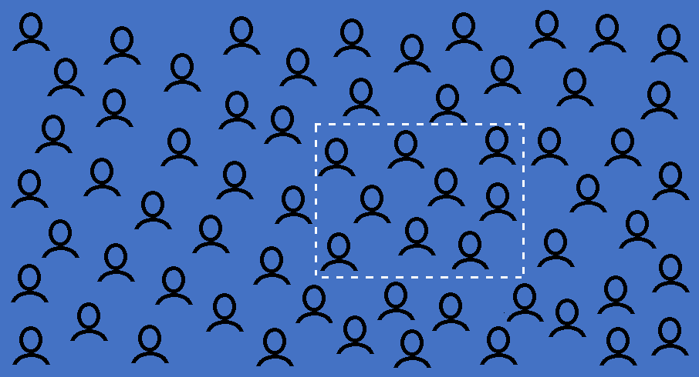
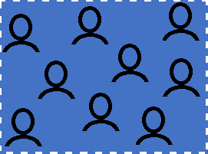
(Un)Fairness in modern medicine
Population
Health
Dataset
Research
Study

New Treatment/
Diagnosis
Clinical
Trial

Slide 27
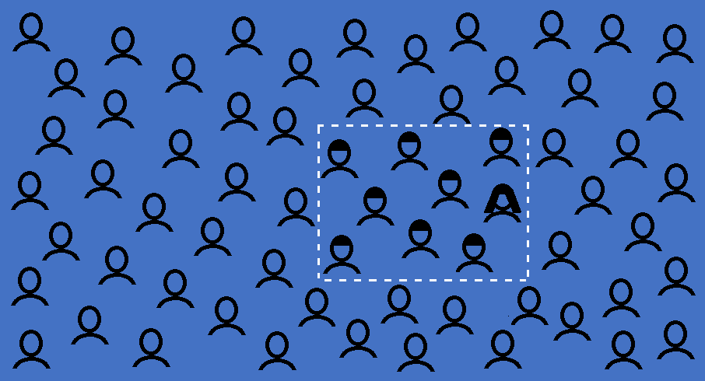
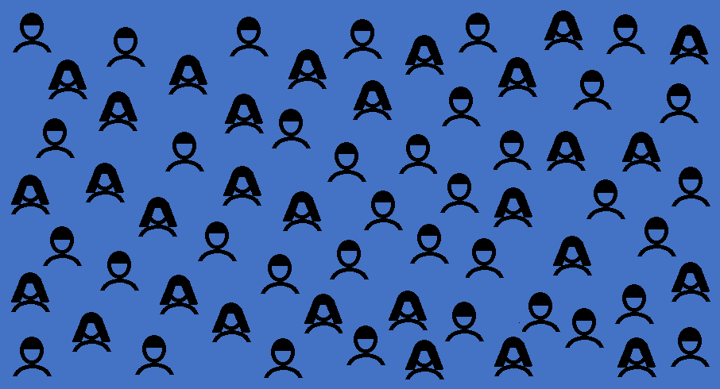
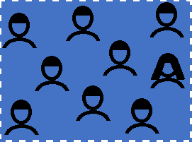
(Un)Fairness in modern medicine - sex
Population
Health
Dataset
Research
Study
?
New Treatment/
Diagnosis
Clinical
Trial

Slide 28


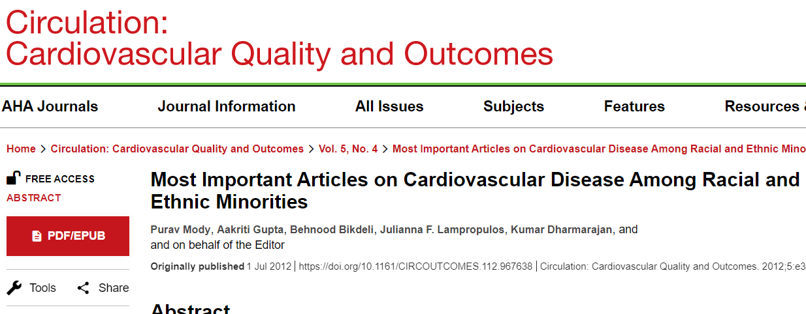
The bad news: Modern medicine is unfair
“… race and ethnicity remain significant predictors of the quality of health care received …”
“… medical research historically has neglected the health needs of women …”
“Steady improvements have been made in the management of cardiovascular disease over the last decade. Yet, certain racial and ethnic minority groups have not experienced equivalent improvements in outcomes …”

Slide 29
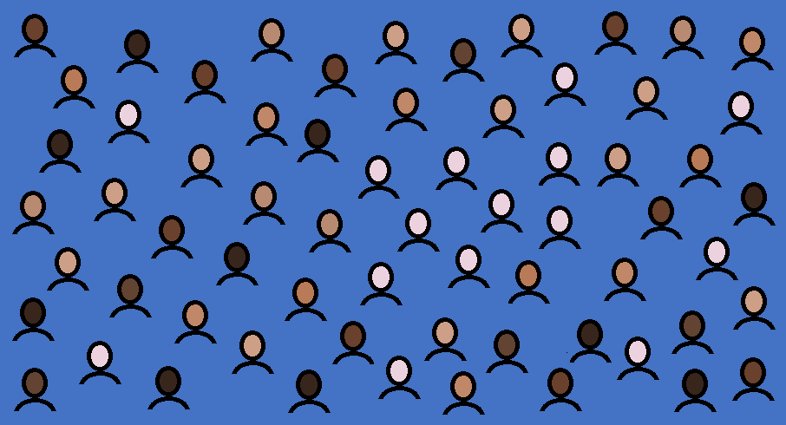
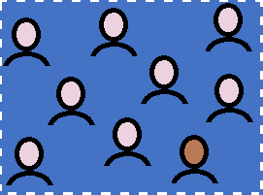
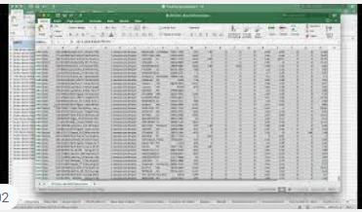
The good news: Can AI be the solution?
Population
Health
Dataset
Research
Study
Fair AI - model differences in race
+ race
information:
Fair AI technique 
New Treatment/
Diagnosis
Clinical
Trial

Slide 30
A brief tour of fair AI in medicine

Slide 31
Literature on fair AI
 | Bias assessment | Addressing bias
General machine learning/AI
Medical imaging
100s or 1000s 100s or 1000s
of papers of papers
<50?
<10?

Slide 32
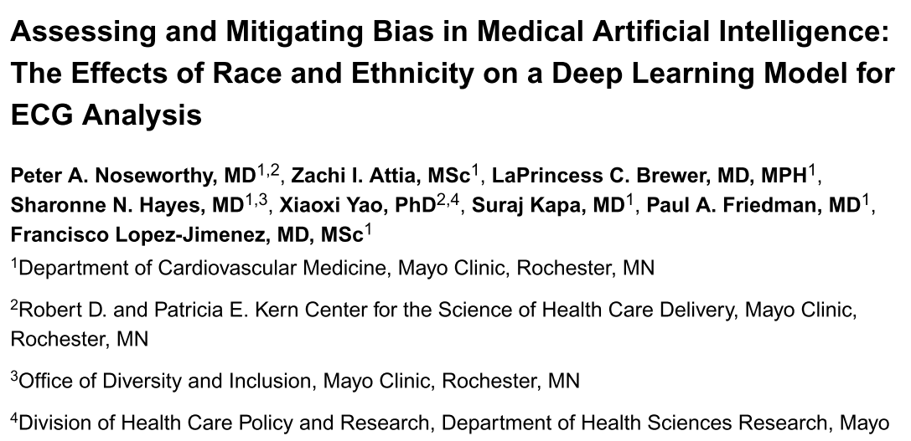
Bias assessment
“We recommend reporting of performance amongst diverse ethnic, racial, age and gender groups for all new AI tools to ensure responsible use of AI in medicine.”

Slide 33
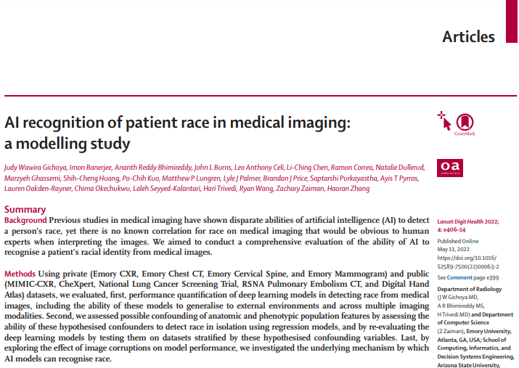
AI can identify race from medical images
2022:
Deep learning models can be trained to predict the race of the subject from multiple medical imaging datasets

Slide 34
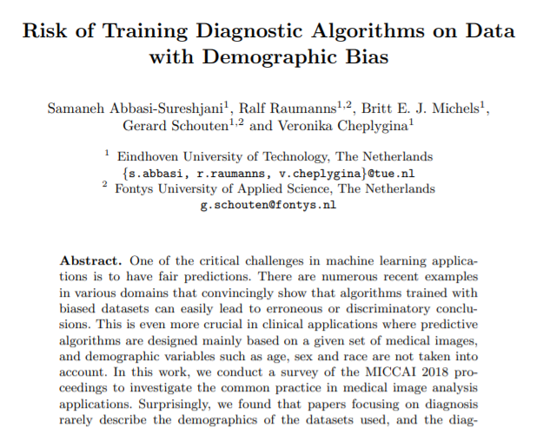
Bias in skin lesion diagnosis
2020:
Highlighted lack of reporting of demographic bias in the literature.
Found bias by protected group (sex, age) in CNN-based skin lesion image classifier, demonstrated simple bias mitigation scheme.

Slide 35
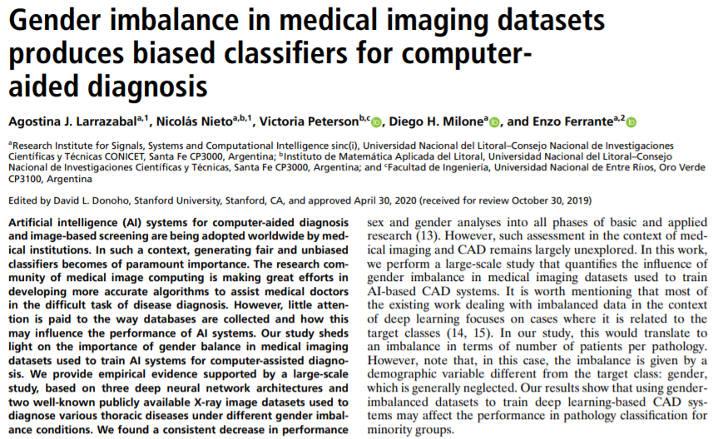
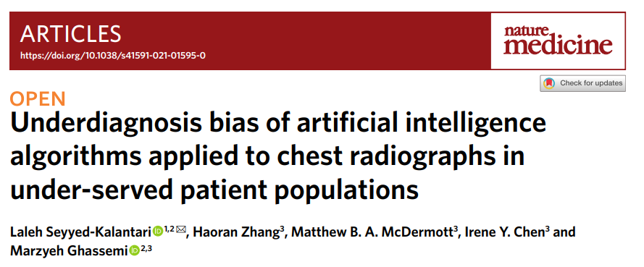
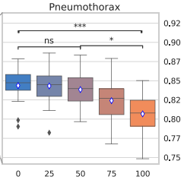
Bias in chest X-ray based AI
2020:
2021:
Found bias by protected group (sex, age, race etc.) in performance of CNN-based chest-X-ray classifiers trained on public datasets.

Slide 36
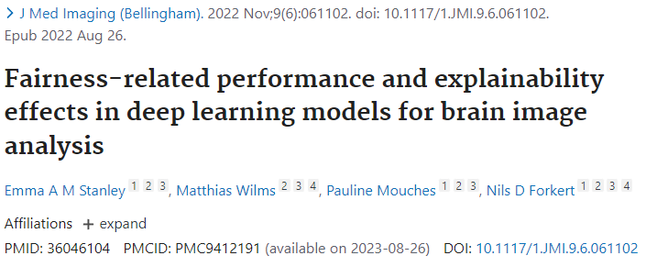
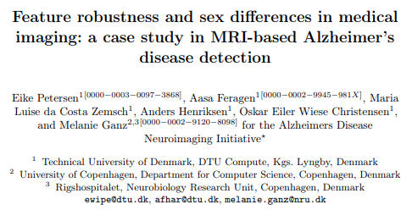
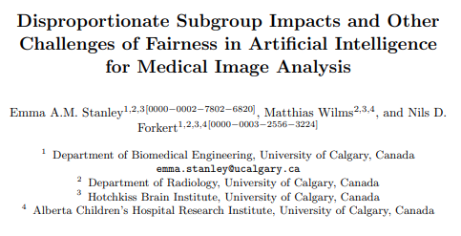
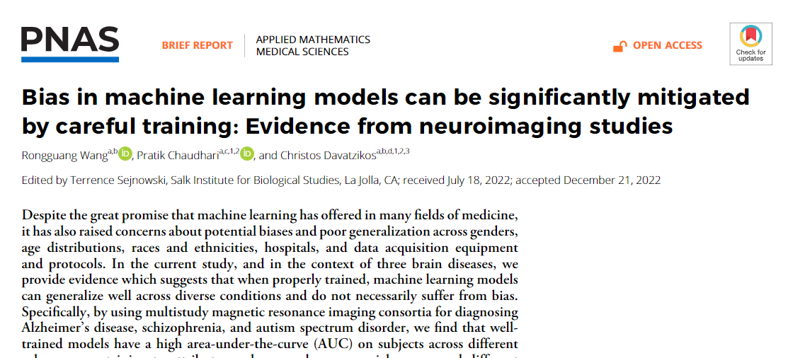
Bias in brain imaging
There may be bias in brain imaging tasks, but likely dependent on task …

Slide 37
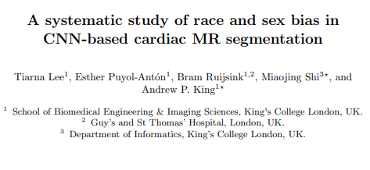
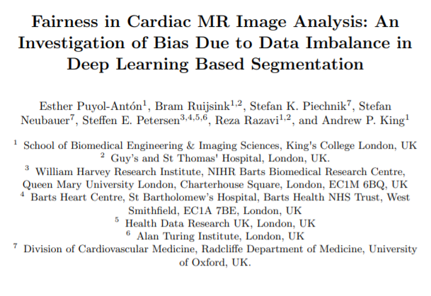
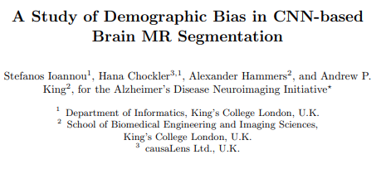
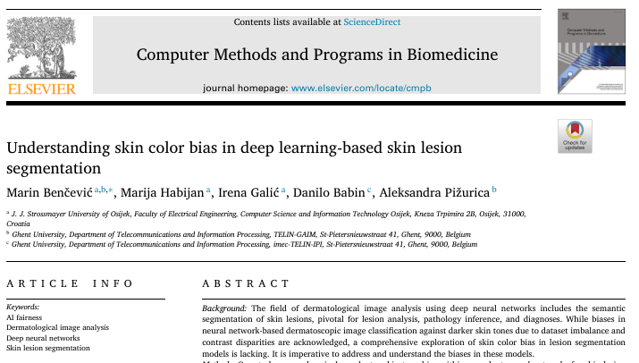
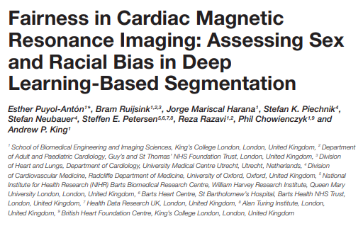
Bias in image segmentation

Slide 38
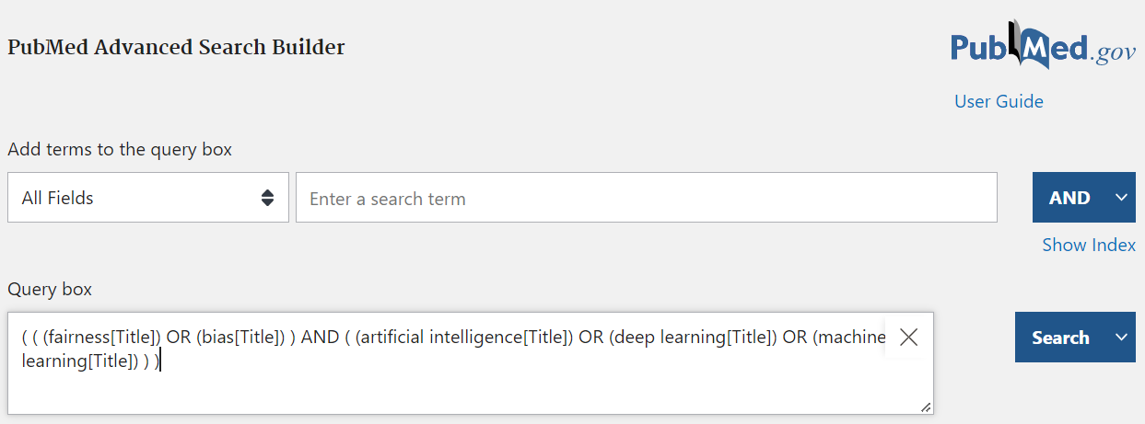
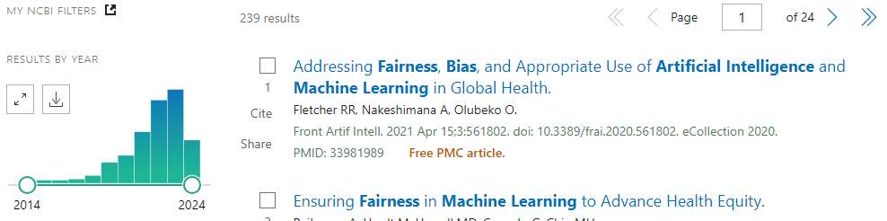
Fairness of AI in Medical Imaging – a growing field!

Slide 39
What is (and isn’t) Fair AI?

Slide 40
Fairness and domain shift
Domain shift – a change in the distribution between a source dataset and a target dataset
In AI, often source=training and target=test …

Slide 41
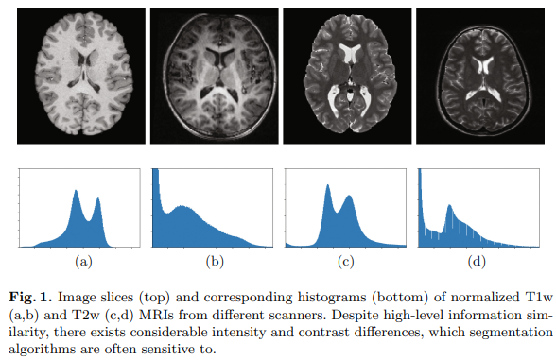

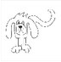



Examples of domain shift
Computer vision
Medical imaging
E.g.
Office-Home
dataset
PACS
dataset
Photo Art Cartoon Sketch
Real-world Product Clipart Art
https://paperswithcode.com/dataset/office-home
https://paperswithcode.com/dataset/pacs
N. Karani, et al. (2018) "A Lifelong Learning Approach to Brain MR Segmentation Across Scanners and Protocols", Proceedings MICCAI.

Slide 42
So is fair AI just demographic domain shift?
A number of works have found similar domain shifts between different protected groups, e.g.
Race

Slide 43



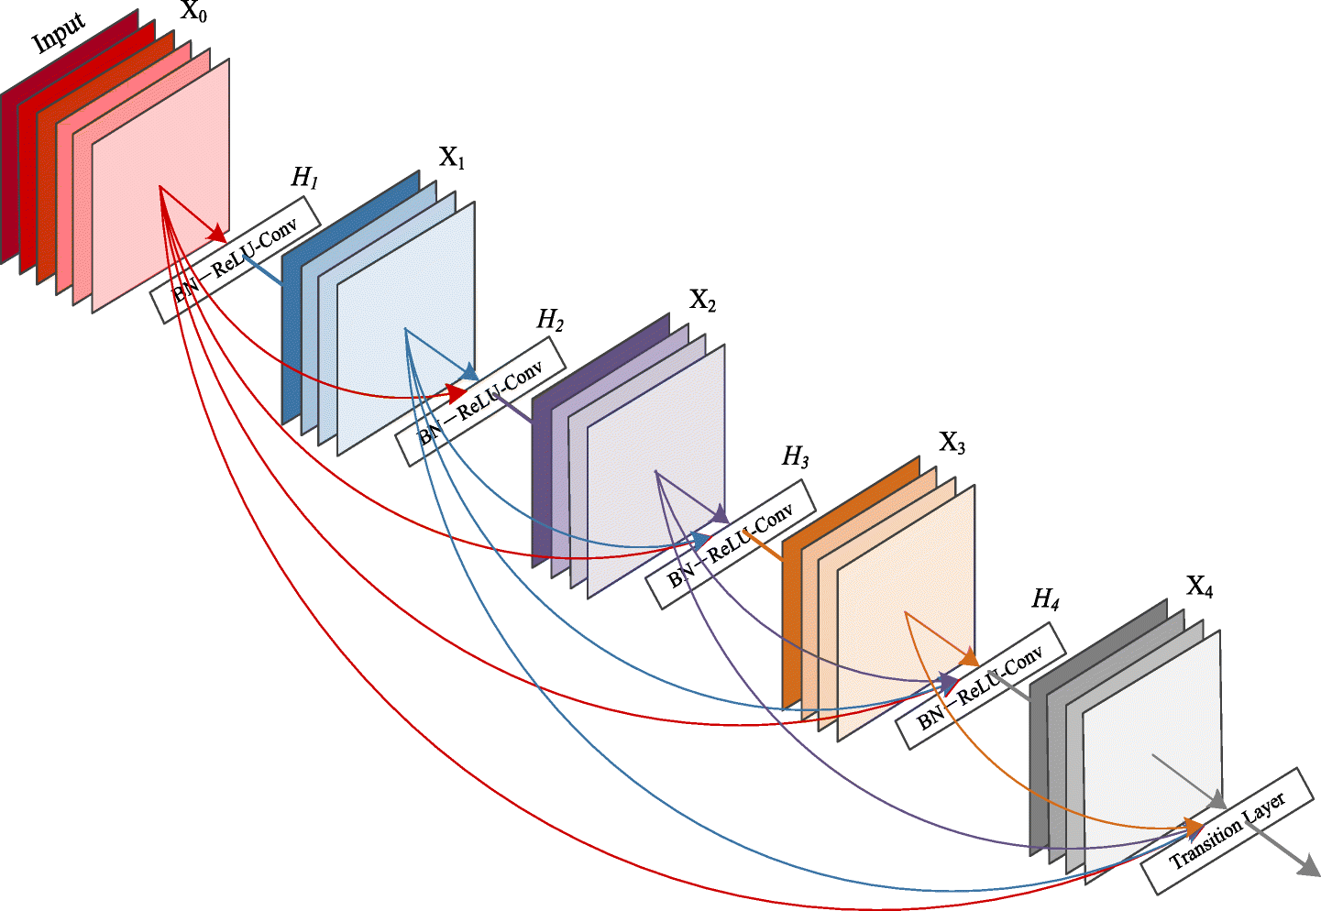


Well yes, but …
Upstream
Demographic domain shift
Problem definition
Data collection
Data preprocessing
Training ML Model
Clinician decision making
Downstream
Diagnosis and treatment
Slide adapted from K. Lekadir

Slide 44
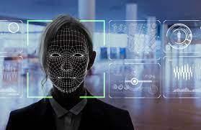
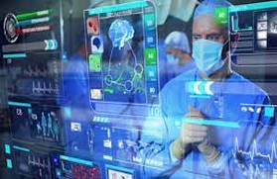
Fair AI in computer vision and medical imaging
Computer vision
Medical imaging
E.g. facial recognition AI:
Nothing known about subject before inference
Seems uncontroversial that we should minimise differences in recognition accuracy
Bias mitigation
E.g. AI-assisted diagnosis:
We know the patient’s sex, race & clinical history
Mitigating bias might adversely affect some protected groups
Do no harm …

Slide 45

Non-maleficence
The ethical principle of doing no harm, expressed in the ancient medical maxim primum non nocere (first do no harm)
In demographic domain shift, there are important ethical considerations when assessing/mitigating bias, e.g.
Cardiac MR segmentation results: (Dice coefficients, high=good)
But when we try to reduce the bias, performance for White subjects gets worse!
-> Performance/fairness trade-off …
Race bias in performance!
www.oxfordreference.com
E. Puyol-Anton, et al. (2022) "Fairness in Cardiac Magnetic Resonance Imaging: Assessing Sex and Racial Bias in Deep Learning-Based Segmentation", Front Cardiovasc Med.

Slide 46




What does fairness mean in a medical context?
2021 paper:
2022 blog:
2022 paper:
www.kclmmag.org/blog/
2022 RadioNuclear podcast:

Slide 47
Summary & resources

Slide 48
Summary
Fair AI is the analysis of biased or toxic behaviour in AI models, and the development of techniques to address this behaviour
Bias should be addressed in all parts of the healthcare AI pipeline, including defining the problem, identifying and collecting the data etc.
Lots of areas for future work in Fair AI for healthcare!

Slide 49
Conclusions …
When implementing AI for medical imaging:
Important to consider “if” and “how” rather than just “can”
Ensure as far as possible that benefits of AI are shared equitably
Be open and transparent about limits of performance

Slide 50
Resources/toolkits for fair AI
AI Fairness 360 - https://aif360.mybluemix.net/
Created by IBM but open-source
Fairlearn - https://fairlearn.org/
Open source, originally Microsoft, self-governing from 2021 - https://fairlearn.org/v0.8/about/index.html
Aequitas - http://www.datasciencepublicpolicy.org/our-work/tools-guides/aequitas/
Open source bias audit toolkit for machine learning developers
MEDFAIR - https://github.com/ys-zong/MEDFAIR
Fairness benchmarking suite for medical imaging

Slide 51
Fairness initiatives
FUTURE-AI - https://future-ai.eu/
Establish guidelines for AI in healthcare, including fairness as key principle
STANDING TOGETHER - https://www.datadiversity.org/
Promotes the formation of inclusive, diverse and transparent medical datasets
FAIMI - https://faimi-workshop.github.io/
Independent academic initiative aimed at exploring and promoting Fair AI in medical imaging

Slide 52

Two events:
MICCAI 2024 workshop
(in-person, Morocco)
+ Free online symposium
(in November 2024)

